Slide 1

Shell Bootcamp 2024 3 Reflections for Week #2
Nayan Khemka
Date : 06-Sept-2024

Slide 2

About Me
Life is what you make it so let’s make it rock

Slide 3

My learnings from this week!

Slide 4
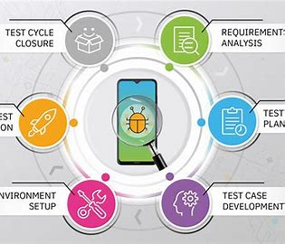
Learning 1 | My takeaways
Software Testing
A test is an activity in which system or component is executed under specific conditions to evaluate it.
Software Testing is the process of evaluating a deliverable with the intent of finding the error
Different Stages of STLC
Different types of testing
TDD – Junit and Fitnesse Tool

Slide 5
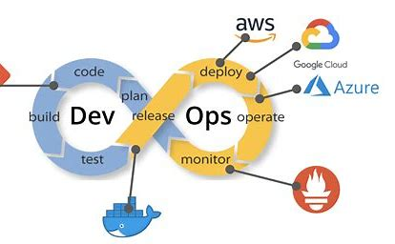
Learning 2 | My takeaways
DevOps on GitHub
Open-source projects
Repositories and deployment
Pull and Push Request
Commits and merging branches
Workflows and Actions on GitHub
Issues and Reviewing Code

Slide 6
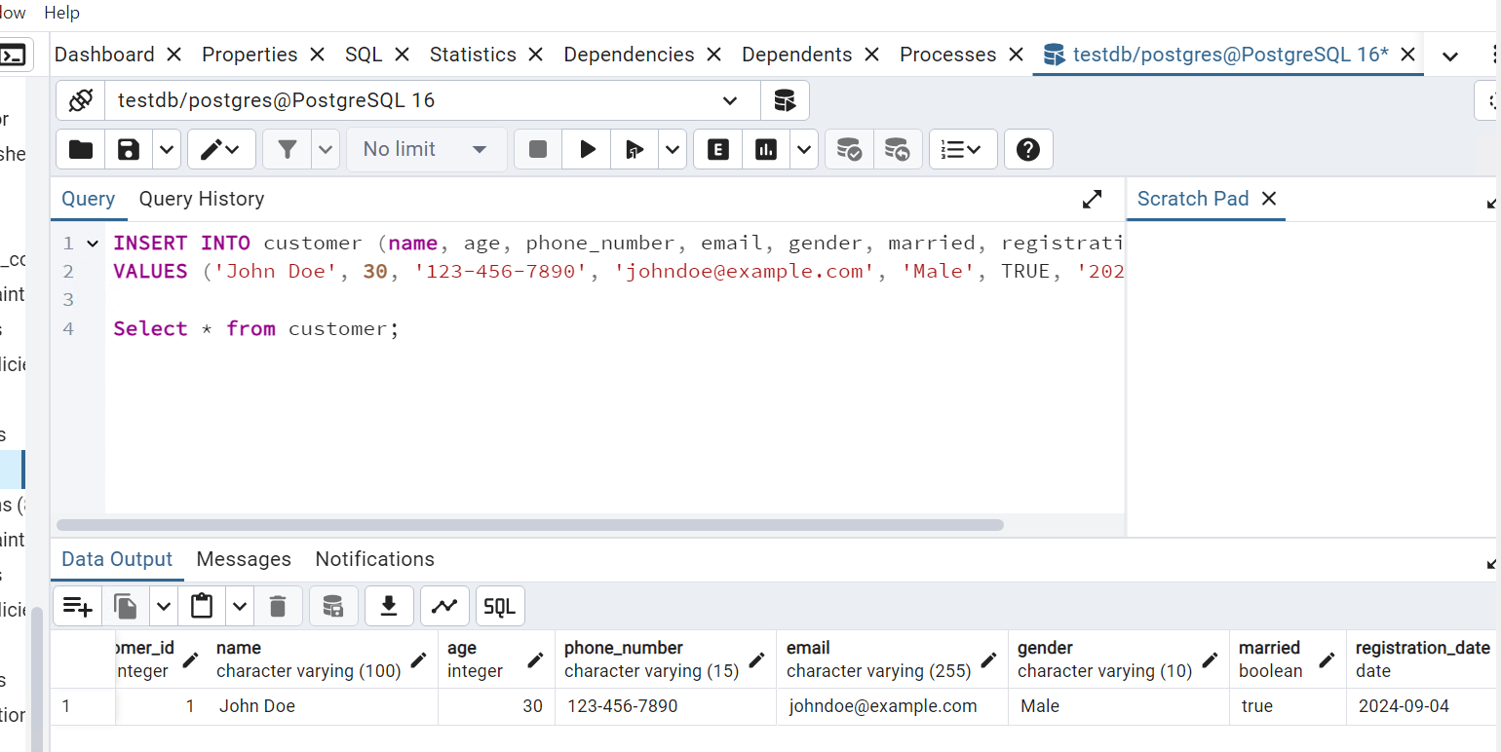
Learning 3 | My takeaways
DBMS
Database Management
Constraints and Triggers
PostGresql
DDL, DML, DCL
This will help me efficiently manage and store vast amounts of data generated from various sources like smart meters, sensors, and IoT devices.
This will also help me analyze large datasets to optimize energy usage, predict demand, and improve energy distribution

Slide 7
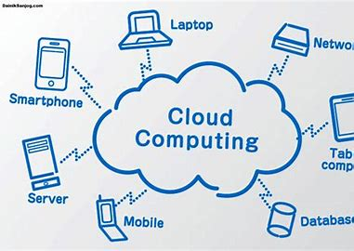
Learning 4 | My takeaways
Cloud
Private, Public and Hybrid Cloud
IaaS, SaaS and PaaS
Benefits of cloud applications
Teraform
Different examples of PaaS, Iaas and SaaS

Slide 8

Relevance of learnings for my organization

Slide 9
Learning 1 | Relevance for Shell
Software testing can significantly benefit me while working in Shell in several ways:
Quality Assurance: Ensures that the software meets the required standards and functions correctly, reducing the risk of bugs and errors.
Cost Efficiency: Identifying and fixing issues early in the development process can save time and money compared to addressing them after deployment.
Security: Helps in identifying vulnerabilities and security flaws, protecting sensitive data and maintaining the integrity of the software.
Compliance: Ensures that the software complies with industry standards and regulations, avoiding legal issues.
Performance: Verifies that the software performs well under various conditions, ensuring a smooth user experience.

Slide 10
Learning 2 | Relevance for Shell
Skill Development: Gain hands-on experience with new DevOps tools and practices that can be applied to Azure DevOps projects.
Integration: Learn how to integrate GitHub with Azure DevOps for a seamless workflow, using GitHub for source control and Azure DevOps for CI/CD pipelines.
Best Practices: Adopt industry best practices and tools to improve efficiency and collaboration within your Azure DevOps environment.
Community Support: Connect with a community of practitioners for knowledge sharing, troubleshooting, and staying updated with the latest trends.
Organizational Benefits: Use the knowledge gained to train employees, improve processes, and experiment with new tools and methodologies in a controlled environment.

Slide 11
Learning 3 | Relevance for Shell
DBMS allows you to store, organize, and retrieve large amounts of data efficiently. This is crucial for managing information in a structured and accessible manner. It provides robust security features to protect your data from unauthorized access and ensures data integrity by maintaining accuracy and consistency.
By automating repetitive tasks and providing tools for data analysis, a DBMS can significantly enhance productivity. This is especially useful in business environments where quick access to data is essential.
DBMS systems are designed to handle growing amounts of data and can be scaled up as needed. They also offer flexibility in terms of data manipulation and reporting.

Slide 12
Learning 4 | Relevance for Shell
Read the Source Thoroughly: Understand the main ideas and arguments by reading the text multiple times.
Identify Core Information: Focus on the most important points, avoiding minor details and examples.
Reflect the Author’s Intention: Ensure your summary accurately represents the original text’s purpose and message.
Write Concisely: Use your own words to condense the information into a shorter form, maintaining clarity and coherence.

Slide 13

Challenges in implementing learning

Slide 14
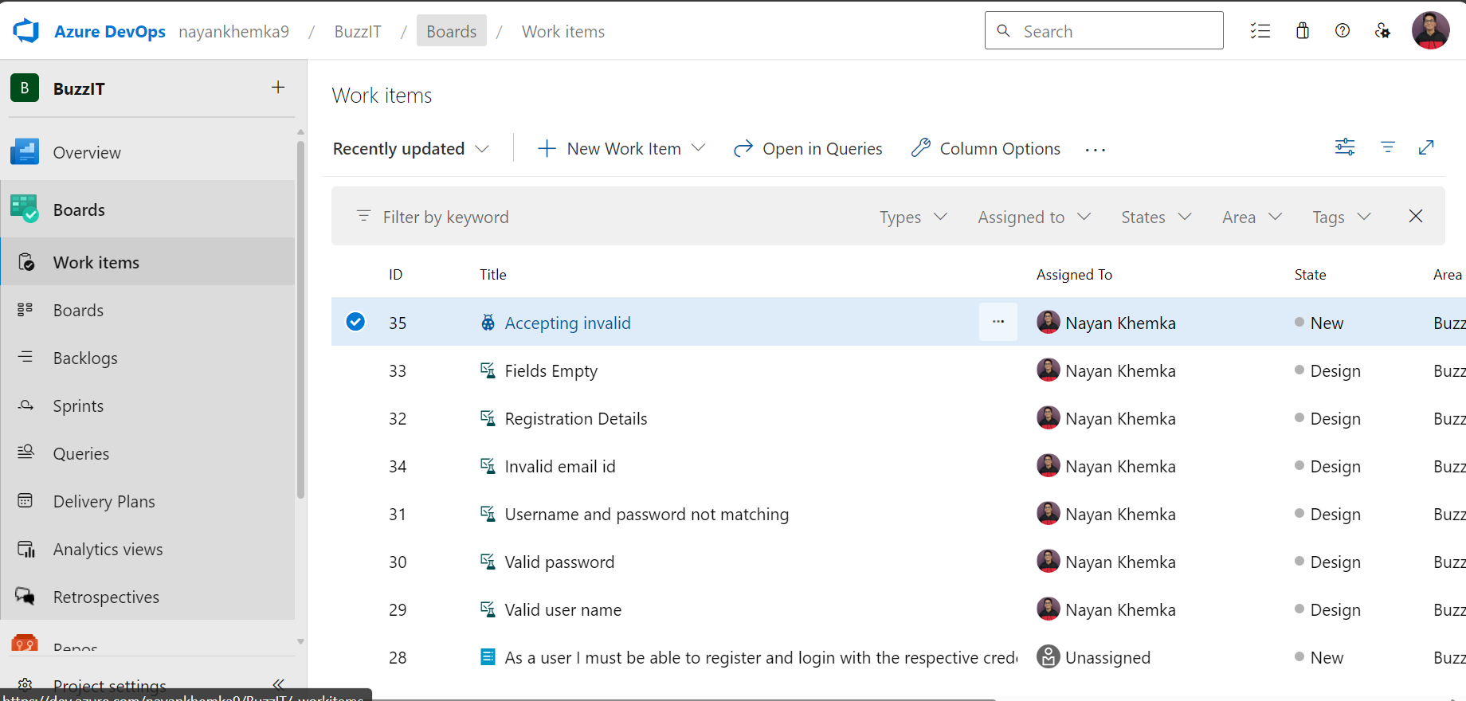
Challenge faced while implementing Learning 1
Implementing Testing concepts on Azure was simple. Understanding the Fitnesse tool and Junit was a bit confusing at first, but the facilitators were very helpful in making us understand how to write different test cases and begin TDD.

Slide 15
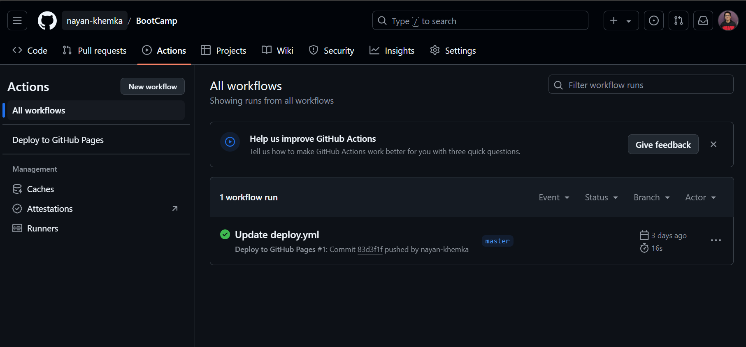
Challenge faced while implementing Learning 2
Understanding how yml and workflow files work was new to me and interesting. Seeing the project being deployed on GitHub pages was interesting.
GitHub link of your solution/documentation:
https://github.com/nayan-Khemka/BootCamp
[Add a graphic that provides evidence of what you did to overcome this challenge]

Slide 16
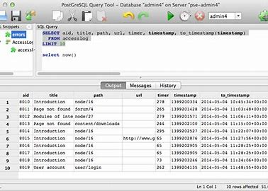
Challenge faced while implementing Learning 3
Created database and tables on PostGressql and executed various different queries.

Slide 17
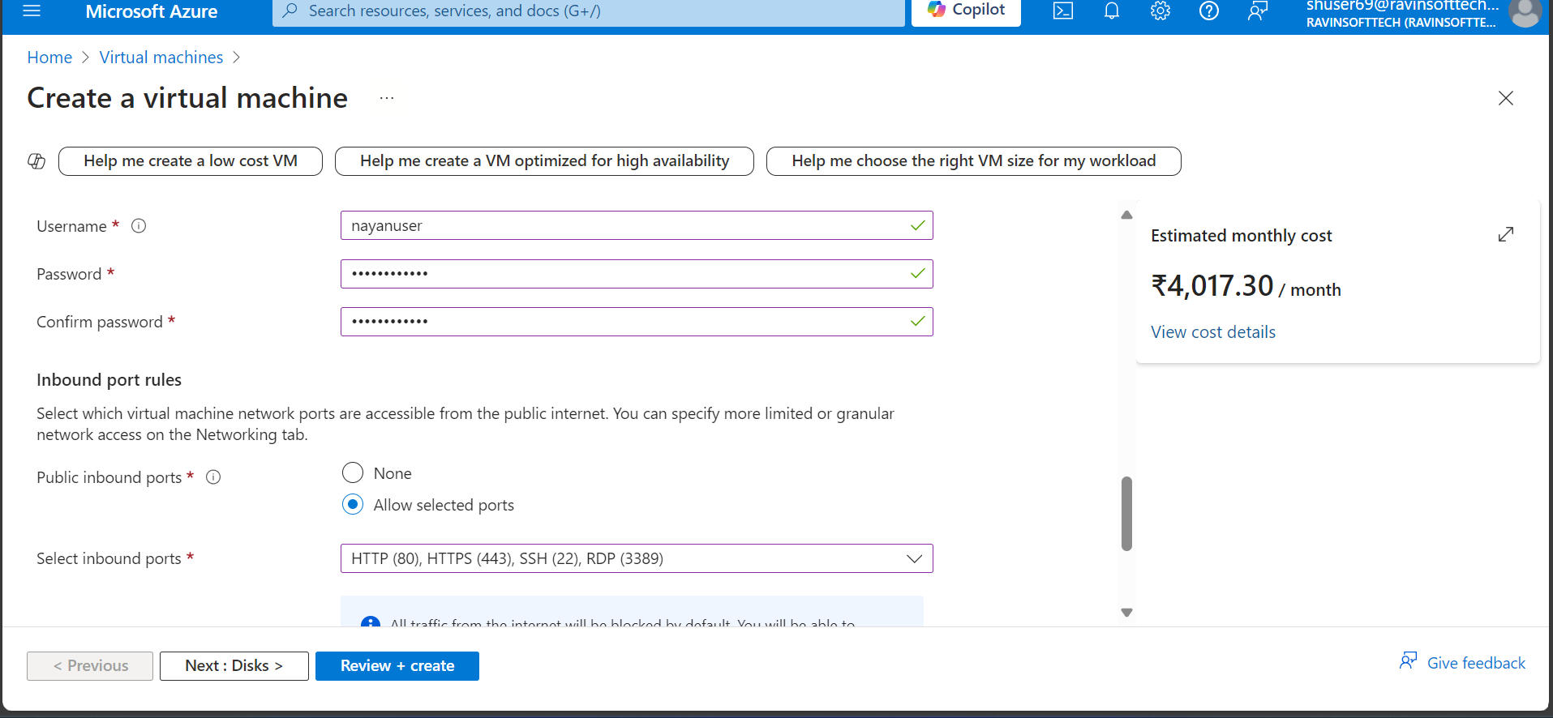
Challenge faced while implementing Learning 4
Created virtual machine on Microsoft Azure and tested it.
[Add a graphic that provides evidence of what you did to overcome this challenge]

Slide 18

Action Plan

Slide 19
My Action Plan for this Week
Actions
Timeline
Status
Perform the final Use case assessment
On Friday apply all the learnings on a particular Use Case
Ongoing

Slide 20

Learning is also Fun!

Slide 21
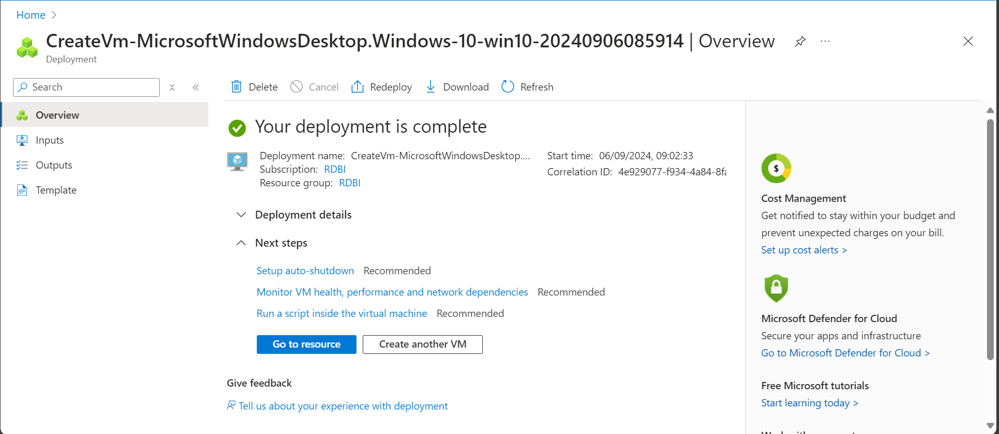
Learning is also Fun!
Hands on practice and activities helped to understand how things actually happen on Azure Cloud.

Slide 22

Summary
Different Stages of STLC
Different types of testing
TDD – Junit and Fitnesse Tool
Open-source projects
Repositories and deployment
Pull and Push Request
Commits and merging branches
Workflows and Actions on GitHub
Issues and Reviewing Code

Slide 23
Thank You

